Slide 1
Network Layer
Pavlos Grigoriadis - pgrigor@csd.uoc.gr
Christina Papachristoudi - chrisp@csd.uoc.gr

Slide 2
Network Layer
Data Plane
How a router forwards the packets that arrive in its incoming interfaces to outgoing interfaces
Consists of:
Header inspection
Implemented mainly in hardware
Follows the instructions given by the Control Plane
Forwarding Table
Control Plane
How a packet is routed among the routers (end-to-end routing).
Consists of:
Implemented mainly in software
Routing Algorithms and Protocols
Routing Table
Notes:
Data Plane
Definition:
Responsible for forwarding packets that arrive on a router’s incoming interfaces to the appropriate outgoing interfaces.
Also called the forwarding plane.
Consists of:
Forwarding Table: Determines the outgoing link for each incoming packet based on its destination address.
Packet Processing Functions:
Header inspection and modification (e.g., decrementing TTL, updating checksums)
Queueing and scheduling for packets in output buffers
Packet classification (for QoS, security, etc.)
Switching Fabric: The internal network that moves packets from input to output ports.
Hardware Components:
High-speed ASICs or NPUs for line-rate packet forwarding
Buffers and queues for congestion management
Key Characteristics:
Operates in real time and at high speed
Implemented mainly in hardware for performance
Follows the instructions given by the Control Plane
—-
Perfect — here’s the Control Plane slide to pair with your Data Plane one:
Control Plane
Definition:
Responsible for deciding how packets should be forwarded.
Manages the routing logic and network intelligence behind the forwarding process.
Also called the routing plane.
Consists of:
Routing Algorithms and Protocols:
e.g., OSPF, BGP, RIP, IS-IS
Determine best paths for data packets through the network
Routing Table:
Built and maintained by routing protocols
Used to populate the forwarding table in the data plane
Signaling and Network Management Functions:
Exchange of routing updates between routers
Network configuration, monitoring, and policy enforcement
Key Characteristics:
Operates logically centralized (in SDN) or distributed (in traditional networks)
Implemented mainly in software (control logic, CPU)
Slower than the data plane but provides intelligence and adaptability
Would you like me to combine both slides into a single PowerPoint layout (e.g., “Data Plane vs Control Plane” comparison slide)? I can generate the .pptx file for you.

Slide 3
Control Plane

Slide 4
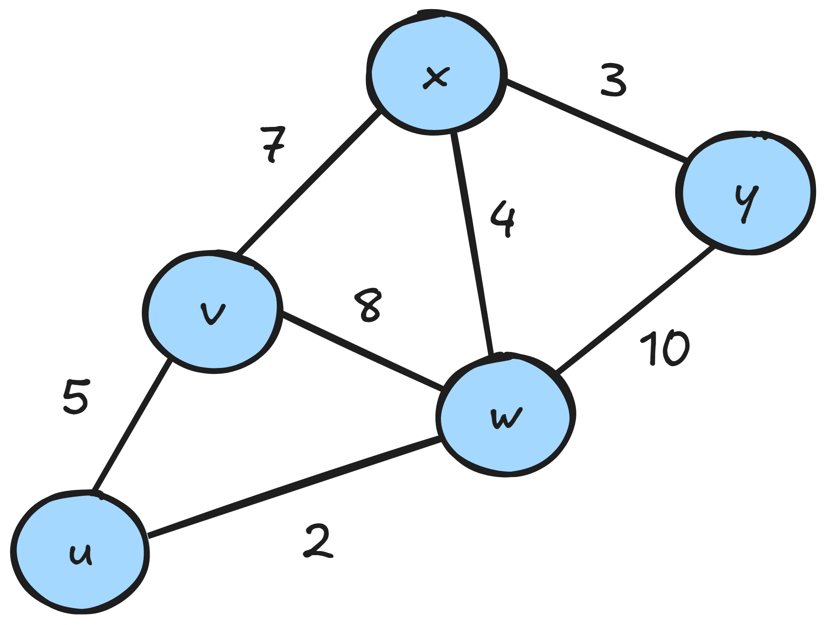
Routing Algorithms
Goal: to find “good” paths from a source to a destination
What is a good path?
  Least-cost Path
  If all link costs are the same then the least-cost
  path is the Shortest Path
Mainly two types of routing algorithms
  Centralized (Link-State)
  Decentralized

Slide 5
Link-State Routing Algorithms
Centralized routing algorithms
Requires knowledge of the entire topology
That means it takes as input:
  All the links between nodes
  All the link costs
How does each node learn all this?
  Link-state broadcast algorithm
  Each node broadcasts its link-state information (links to neighbors, costs)
  At the end every node has the same complete view of the topology
  Now each node can run the LS algorithm and find the same least-cost paths

Slide 6
Dijkstra Algorithm
A link-state algorithm
Computes all the least-cost paths from
a source node to all other nodes of the topology
For k nodes it needs k iterations to complete

Slide 7
Dijkstra Algorithm
Find the least-cost paths from u to every other router
D(v): Distance from u to v
p(v): previous node of v on the current path
Nodes | D(v), p(v) | D(w), p(w) | D(x), p(x) | D(y), p(y)
u | 5, u | 2, u | ∞, - | ∞, -

Slide 8
Dijkstra Algorithm
Choose w because it has the smallest distance
Add it to the nodes
Nodes | D(v), p(v) | D(w), p(w) | D(x), p(x) | D(y), p(y)
u | 5, u | 2, u | ∞, - | ∞, -
uw | 5, u (10, w) | - | 6, w | 12, w

Slide 9
Dijkstra Algorithm
Nodes | D(v), p(v) | D(w), p(w) | D(x), p(x) | D(y), p(y)
u | 5, u | 2, u | ∞, - | ∞, -
uw | 5, u | - | 6, w | 12, w
uwv | - | - | 6, w (12, v) | 12, w

Slide 10
Dijkstra Algorithm
Nodes | D(v), p(v) | D(w), p(w) | D(x), p(x) | D(y), p(y)
u | 5, u | 2, u | ∞, - | ∞, -
uw | 5, u | - | 6, w | 12, w
uwv | - | - | 6, w | 12, w
uwvx | - | - | - | 12, w (9, x)

Slide 11
Dijkstra Algorithm
Nodes | D(v), p(v) | D(w), p(w) | D(x), p(x) | D(y), p(y)
u | 5, u | 2, u | ∞, - | ∞, -
uw | 5, u | - | 6, w | 12, w
uwv | - | - | 6, w | 12, w
uwvx | - | - | - | 9, x
uwvxy | - | - | - | -

Slide 12
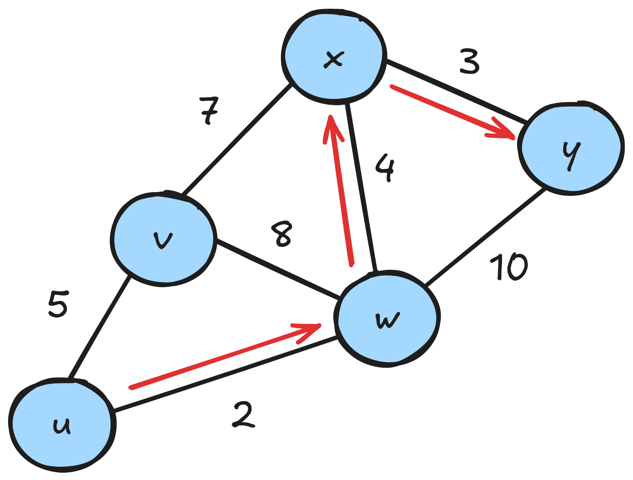
Dijkstra Algorithm
So to find the path from, let’s say, u → y,
we choose y and go backwards:
Previous of y? p(y) = x
p(x) = w
p(w) = u
Path u→y: u → w → x → y
Nodes | D(v), p(v) | D(w), p(w) | D(x), p(x) | D(y), p(y)
u | 5, u | 2, u | ∞, - | ∞, -
uw | 5, u | - | 6, w | 12, w
uwv | - | - | 6, w | 12, w
uwvx | - | - | - | 9, x
uwvxy | - | - | - | -

Slide 13
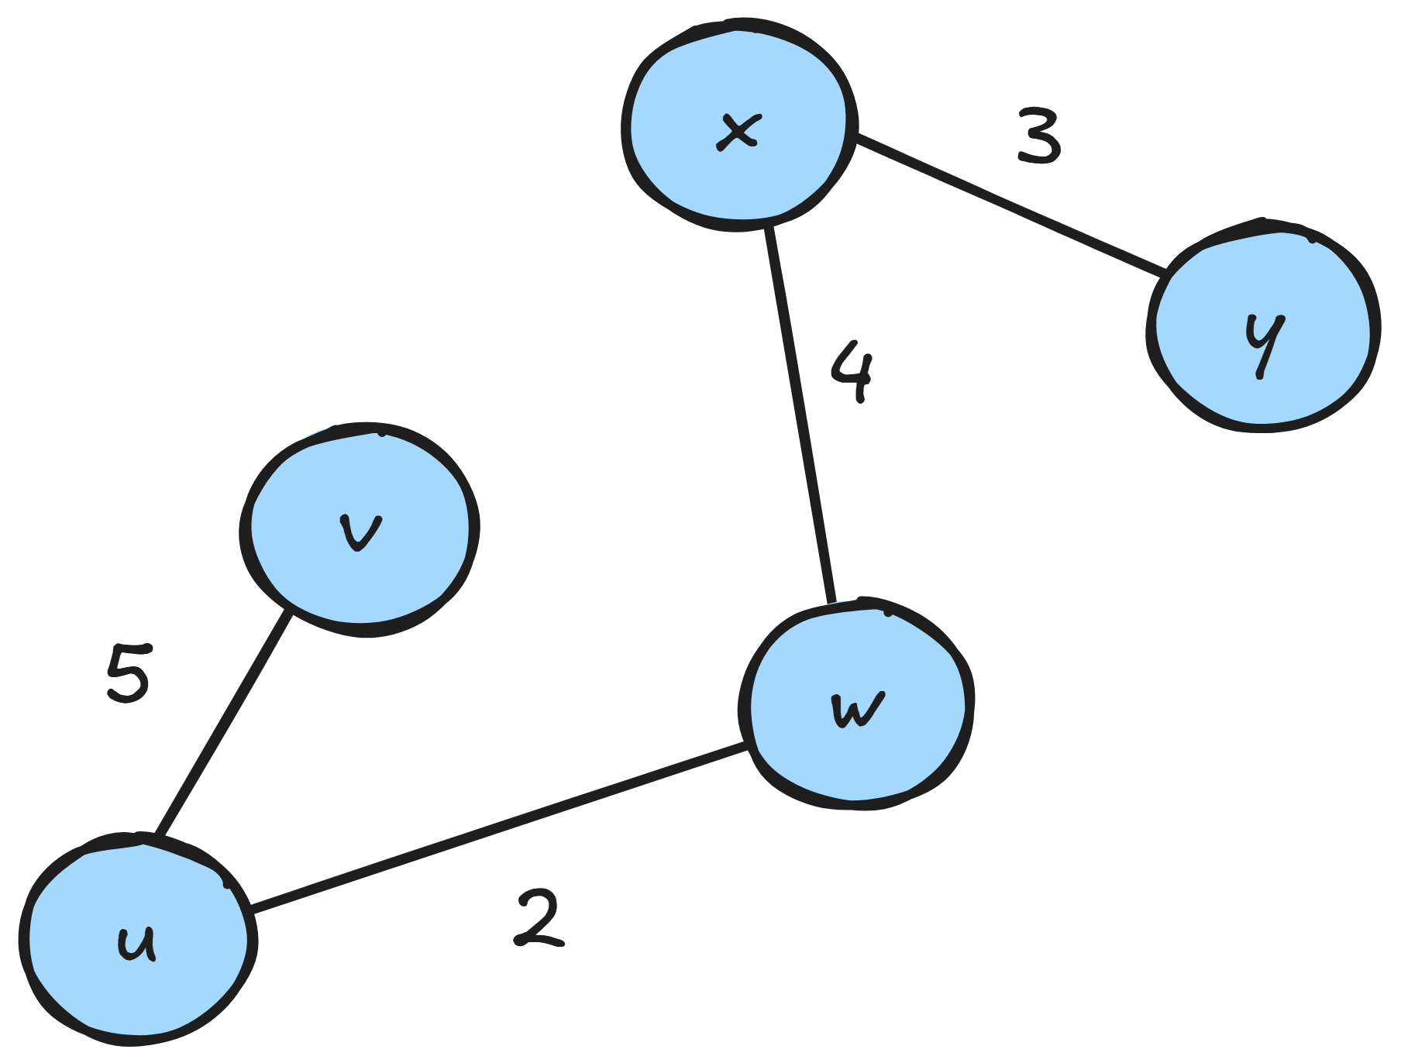
Dijkstra Algorithm - Least-Cost Graph
To find the least-cost graph:
Find least-cost paths from u to all other nodes
Keep only the nodes and links that exist in
these paths

Slide 14
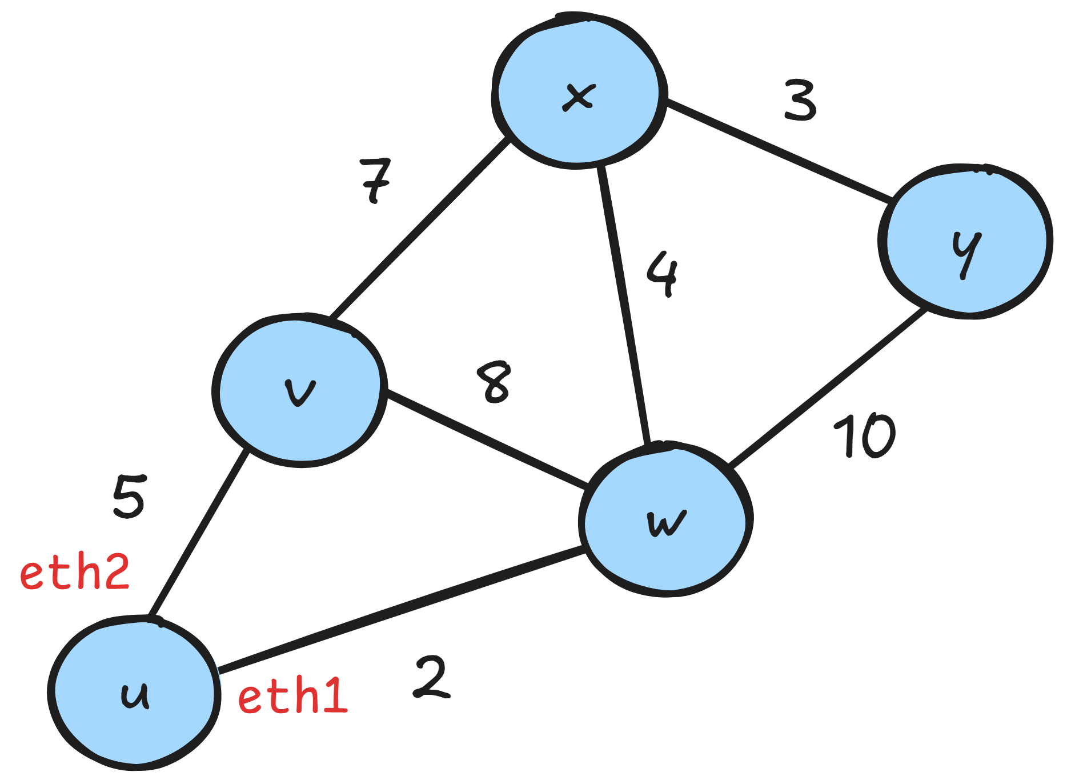
Populating Forwarding Table
Routing algorithms are used to fill up the forwarding table
Based on the least-cost paths:
  Path to y: u → w → x → y
  So in order to reach y → send to w
  So for destination y the outgoing interface: eth1
  And so on…
Destination | Interface
w | eth1
v | eth2
x | eth1
y | eth1

Slide 15
Decentralized Algorithms
Each node only knows about the link costs that are directly connected to it
Each node gets/sends updates from/to its neighbors (only!)
Iterative
  Based on these updates each node calculates the new least-cost path
  These updates continue until there aren’t any more changes
  The algorithm has converged

Slide 16
Distance Vector
Decentralized routing algorithm
Keeps a vector of all the costs (distances) to the other nodes
  hence the name distance vector
Uses the Bellman-Ford equation

Slide 17
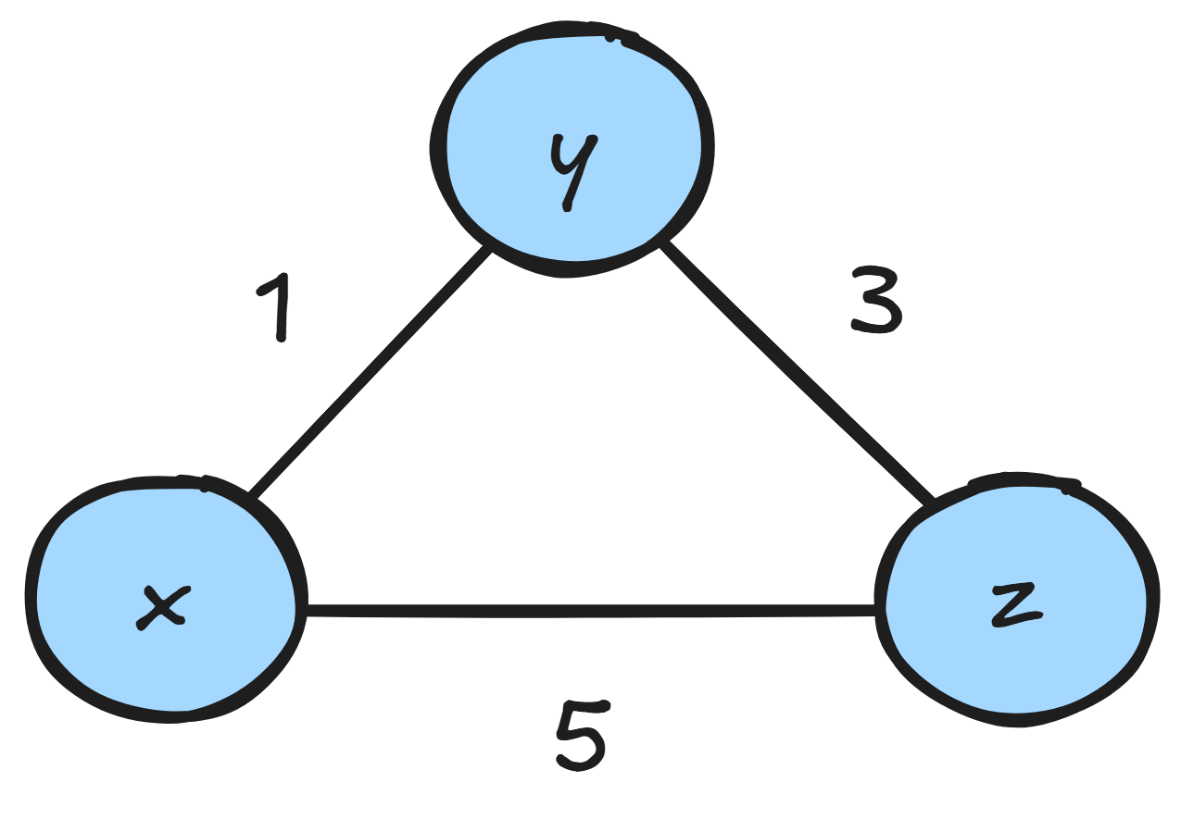
Distance Vector
Initialization state
Table of node x
 | x | y | z
x | 0 | 1 | 5
y | ∞ | ∞ | ∞
z | ∞ | ∞ | ∞
Table of node y
 | x | y | z
x | ∞ | ∞ | ∞
y | 1 | 0 | 3
z | ∞ | ∞ | ∞
Table of node z
 | x | y | z
x | ∞ | ∞ | ∞
y | ∞ | ∞ | ∞
z | 5 | 3 | 0

Slide 18
Distance Vector
Each node advertises its table to the neighbors
Table of node x
 | x | y | z
x | 0 | 1 | 5
y | 1 | 0 | 3
z | 5 | 3 | 0
Table of node y
 | x | y | z
x | 0 | 1 | 5
y | 1 | 0 | 3
z | 5 | 3 | 0
Table of node z
 | x | y | z
x | 0 | 1 | 5
y | 1 | 0 | 3
z | 5 | 3 | 0
x will advertise table to y, z
y will advertise table to x, z
z will advertise table to x, y

Slide 19
Distance Vector
Bellman-Ford Equation:
D_{x}(y) = min_{v} { c(x, v) + D_{v}(y) }
D_{x}(y): the least cost from x to y
c(x, v): the current cost from x to v (based on the current value of node x’s vector)
D_{v}(y): the least cost from a node v to y
Algorithm runs for every node v that is a neighbor of x
Table of node x
 | x | y | z
x | 0 | 1 | 5
y | 1 | 0 | 3
z | 5 | 3 | 0
For neighbor z:
c(x, z) = 5
D_{z}(y) = 3
For neighbor y:
c(x, y) = 1
D_{y}(y) = 0

Slide 20
Distance Vector
Bellman-Ford Equation:
D_{x}(y) = min_{v} { c(x, v) + D_{v}(y) }
D_{x}(y): the least cost from x to y
c(x, v): the current cost from x to v (based on the current value of node x’s vector)
D_{v}(y): the least cost from a node v to y
Algorithm runs for every node v that is a neighbor of x
Table of node x
 | x | y | z
x | 0 | 1 | 5
y | 1 | 0 | 3
z | 5 | 3 | 0
For neighbor z:
c(x, z) = 5
D_{z}(y) = 3
For neighbor y:
c(x, y) = 1
D_{y}(y) = 0

Slide 21
Distance Vector
Bellman-Ford Equation:
D_{x}(y) = min_{v} { c(x, v) + D_{v}(y) }
D_{x}(y): the least cost from x to y
c(x, v): the current cost from x to v (based on the current value of node x’s vector)
D_{v}(y): the least cost from a node v to y
Algorithm runs for every node v that is a neighbor of x
Table of node x
 | x | y | z
x | 0 | 1 | 5
y | 1 | 0 | 3
z | 5 | 3 | 0
For neighbor z:
c(x, z) = 5
D_{z}(y) = 3
For neighbor y:
c(x, y) = 1
D_{y}(y) = 0

Slide 22
Distance Vector
Bellman-Ford Equation:
D_{x}(y) = min_{v} { c(x, v) + D_{v}(y) }
D_{x}(y): the least cost from x to y
c(x, v): the current cost from x to v (based on the current value of node x’s vector)
D_{v}(y): the least cost from a node v to y
Algorithm runs for every node v that is a neighbor of x
Table of node x
 | x | y | z
x | 0 | 1 | 5
y | 1 | 0 | 3
z | 5 | 3 | 0
For neighbor z:
c(x, z) = 5
D_{z}(y) = 3
For neighbor y:
c(x, y) = 1
D_{y}(y) = 0

Slide 23
Distance Vector
Bellman-Ford Equation:
D_{x}(y) = min_{v} { c(x, v) + D_{v}(y) }
D_{x}(y): the least cost from x to y
c(x, v): the current cost from x to v (based on the current value of node x’s vector)
D_{v}(y): the least cost from a node v to y
Algorithm runs for every node v that is a neighbor of x
Table of node x
 | x | y | z
x | 0 | 1 | 5
y | 1 | 0 | 3
z | 5 | 3 | 0
For neighbor z:
c(x, z) = 5
D_{z}(y) = 3
For neighbor y:
c(x, y) = 1
D_{y}(y) = 0

Slide 24
Distance Vector
Bellman-Ford Equation:
D_{x}(y) = min_{v} { c(x, v) + D_{v}(y) }
For z: D_{x}(y) = c(x, z) + D_{z}(y) = 5 + 3 = 8
For y: D_{x}(y) = c(x, y) + D_{y}(y) = 1 + 0 = 1
So finally: D_{x}(y) = min_{v} { c(x, v) + D_{v}(y) } = min(8, 1) = 1
We re-calculated the distance from to x to y based on the
neighbors’ updates.
We update x’s vector with the new value.
(In this case it stays the same = 1)
Table of node x
 | x | y | z
x | 0 | 1 | 5
y | 1 | 0 | 3
z | 5 | 3 | 0

Slide 25
Distance Vector
Each node re-calculates its vector taking into account the vectors of its neighbor
Table of node x
 | x | y | z
x | 0 | 1 | 5
y | 1 | 0 | 3
z | 5 | 3 | 0
Table of node y
 | x | y | z
x | 0 | 1 | 5
y | 1 | 0 | 3
z | 5 | 3 | 0
Table of node z
 | x | y | z
x | 0 | 1 | 5
y | 1 | 0 | 3
z | 5 | 3 | 0
y: D_{x}(y) = c(x,y) + D_{y}(y) = 1+0 = 1
y: D_{x}(z) = c(x,y) + D_{y}(z) = 1+3 = 4
z: D_{x}(y) = c(x,z) + D_{z}(y) = 5+3 = 8
z: D_{x}(z) = c(x,z) + D_{z}(z) = 5+0 = 5
x: D_{y}(x) = c(y,x) + D_{x}(x) = 1 0 = 1
y: D_{y}(z) = c(y,x) + D_{x}(z) = 1+5 = 6
z: D_{y}(x) = c(y,z) + D_{z}(x) = 3+5 = 8
y: D_{y}(z) = c(y,z) + D_{z}(z) = 3+0 = 3
x: D_{z}(x) = c(z,x) + D_{x}(x) = 5+0 = 5
y: D_{z}(y) = c(z,x) + D_{x}(y) = 5+1 = 6
y: D_{z}(x) = c(z,y) + D_{y}(x) = 3+1 = 4
y: D_{z}(y) = c(z,y) + D_{y}(y) = 3+0 = 3

Slide 26
Distance Vector
Each node updates its vector with the smallest distance
Table of node x
 | x | y | z
x | 0 | 1 | 4
y | 1 | 0 | 3
z | 5 | 3 | 0
Table of node y
 | x | y | z
x | 0 | 1 | 5
y | 1 | 0 | 3
z | 5 | 3 | 0
Table of node z
 | x | y | z
x | 0 | 1 | 5
y | 1 | 0 | 3
z | 4 | 3 | 0
y: D_{x}(y) = c(x,y) + D_{y}(y) = 1+0 = 1
y: D_{x}(z) = c(x,y) + D_{y}(z) = 1+3 = 4
z: D_{x}(y) = c(x,z) + D_{z}(y) = 5+3 = 8
z: D_{x}(z) = c(x,z) + D_{z}(z) = 5+0 = 5
x: D_{y}(x) = c(y,x) + D_{x}(x) = 1+0 = 1
y: D_{y}(z) = c(y,x) + D_{x}(z) = 1+5 = 6
z: D_{y}(x) = c(y,z) + D_{z}(x) = 3+5 = 8
y: D_{y}(z) = c(y,z) + D_{z}(z) = 3+0 = 3
x: D_{z}(x) = c(z,x) + D_{x}(x) = 5+0 = 5
y: D_{z}(y) = c(z,x) + D_{x}(y) = 5+1 = 6
y: D_{z}(x) = c(z,y) + D_{y}(x) = 3+1 = 4
y: D_{z}(y) = c(z,y) + D_{y}(y) = 3+0 = 3

Slide 27
Distance Vector
Each node advertises its updated table to the neighbors
Table of node x
 | x | y | z
x | 0 | 1 | 4
y | 1 | 0 | 3
z | 4 | 3 | 0
Table of node y
 | x | y | z
x | 0 | 1 | 4
y | 1 | 0 | 3
z | 4 | 3 | 0
Table of node z
 | x | y | z
x | 0 | 1 | 4
y | 1 | 0 | 3
z | 4 | 3 | 0
x will advertise table to y, z
y’s vector did not change so it does not advertise
z will advertise table to x, y

Slide 28
Distance Vector
Each node re-calculates its vector
There are no changes → the algorithm has converged!
Table of node x
 | x | y | z
x | 0 | 1 | 4
y | 1 | 0 | 3
z | 4 | 3 | 0
Table of node y
 | x | y | z
x | 0 | 1 | 4
y | 1 | 0 | 3
z | 4 | 3 | 0
Table of node z
 | x | y | z
x | 0 | 1 | 4
y | 1 | 0 | 3
z | 4 | 3 | 0
z: D_{x}(y) = c(x,z) + D_{z}(y) = 4+3 = 7
z: D_{x}(z) = c(x,z) + D_{z}(z) = 4+0 = 4
x: D_{y}(x) = c(y,x) + D_{x}(x) = 1+0 = 1
y: D_{y}(z) = c(y,x) + D_{x}(z) = 1+4 = 5
z: D_{y}(x) = c(y,z) + D_{z}(x) = 3+4 = 7
y: D_{y}(z) = c(y,z) + D_{z}(z) = 3+0 = 3
x: D_{z}(x) = c(z,x) + D_{x}(x) = 4+0 = 4
y: D_{z}(y) = c(z,x) + D_{x}(y) = 4+1 = 5

Slide 29
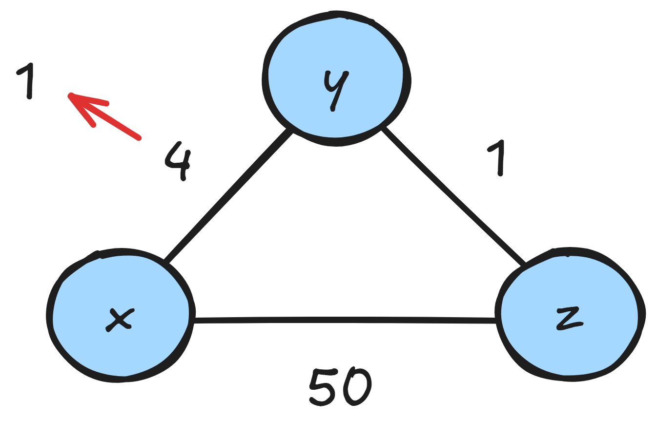
Distance Vector - Good News Travels Fast
Link (x-y) changes cost: 4 → 1
t₀: y detects the change
  updates its vector
  notifies its neighbors
t₁: z receives update from y
  updates its vector for z → x: 5 → 2
  notifies its neighbors
t₂: y receives update from z
  updates its table
  least costs have not changed → does not advertise
  algorithm has converged

Slide 30
Distance Vector - Good News Travels Fast
Link (x-y) changes cost: 4 → 1
t₀: y detects the change
  updates its vector
  notifies its neighbors
t₁: z receives update from y
  updates its vector for z → x: 5 → 2
  notifies its neighbors
t₂: y receives update from z
  updates its table
  least costs have not changed → does not advertise
  algorithm has converged
Only 2 iterations for the algorithm to converge → Good news travels fast! 🐇

Slide 31
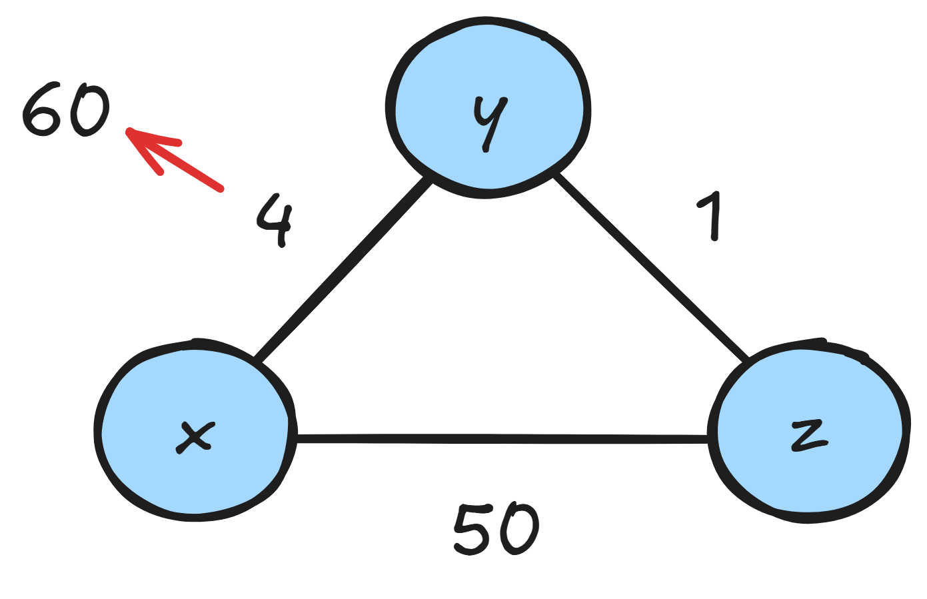
Distance Vector - Bad News Travels Slow
Before change: D_{y}(x) = 4, D_{y}(z) = 1, D_{z}(y) = 1, D_{z}(x) = 5
Link (x-y) changes cost: 4 → 60
t₀: y detects the change
  Calculates new cost to x
  D_{y}(x) = min { c(x, y) + D_{x}(x), c(y, z) + D_{z}(x) } = min { 60 + 0, 1 + 5 } = 6
  By looking at the graph we can tell that this new cost is obviously wrong
  But node y only knows what is in its table
  So node y, in order to reach x, will route through z
    expecting z to be able to reach x with only cost 5
  Routing loop
    node y, in order to reach x, will route through z
    node z, in order to reach x, will route through y

Slide 32

Distance Vector - Bad News Travels Slow
Before change: D_{y}(x) = 4, D_{y}(z) = 1, D_{z}(y) = 1, D_{z}(x) = 5
Link (x-y) changes cost: 4 → 60
t₀: y detects the change
  Calculates new cost to x
  D_{y}(x) = min { c(x, y) + D_{x}(x), c(y, z) + D_{z}(x) } = min { 60 + 0, 1 + 5 } = 6
  By looking at the graph we can tell that this new cost is obviously wrong
  But node y only knows what is in its table
  So node y, in order to reach x, will route through z
    expecting z to be able to reach x with only cost 5
  Routing loop
    node y, in order to reach x, will route through z
    node z, in order to reach x, will route through y
    ping-pong situation

Slide 33
Distance Vector - Bad News Travels Slow
t₁: y calculates new cost to x
  Notifies z
t₁: z receives update: D_{y}(x) = 6
  Calculates new cost to x
  D_{z}(x) = min{ 50 + 0, 1 + 6 } = 7
  Updates its vector
  Notifies y
y receives update, calculates new D_{y}(x) = 8
z receives update, calculates new D_{y}(x) = 9
and so on…

Slide 34
Distance Vector - Bad News Travels Slow
How long will this go on?
  44 iterations
  Until z calculates that the cost through y is higher than 50
  z will set the path to x through the direct link with x
  y will set the path to x through z
Count-to-Infinity Problem
  Because of the many iterations
44 iterations for the algorithm to converge → Bad news travels slow! 🐢

Slide 35
Distance Vector - Poisoned Reverse
The previous scenario can be avoided
Using a technique called poisoned reverse
  If z routes through y to reach z
  Then z will tell y that its distance from x is infinite: D_{z}(x) = ∞
  y now believes that z does not have a route to x
  So y will not try to route though z to reach x
When the change from 4 to 60 happens:
  y updates its table
  Keeps routing to x via the direct link
  Informs z about its new cost to x: D_{y}(x) = 60

Slide 36
Distance Vector - Poisoned Reverse
z receives update from y
  changes its vector the cost of the direct link: D_{z}(x) = 50
  notifies y
y receives update from z
  changes its vector: D_{y}(x) = 51
  now y is the one doing the poisoning
  tells z that D_{y}(x) = ∞

Slide 37

Distance Vector - Poisoned Reverse
z receives update from y
  changes its vector the cost of the direct link: D_{z}(x) = 50
  notifies y
y receives update from z
  changes its vector: D_{y}(x) = 51
  now y is the one doing the poisoning
  tells z that D_{y}(x) = ∞
Does poisoned reverse solve the count-to-infinity problem?
No, if the loops included 3 or more nodes, they would not be detected.

Slide 38
Autonomous System
A group of routers which operate under the same management
Each AS has a unique number identifier called Autonomous System Number (ASN) (ex. 6867)
The routers of each AS share a common prefix (ex. 147.52.0.0/16)
Each organization (Facebook, Google, Amazon etc.) has one or more ASes in different locations

Slide 39
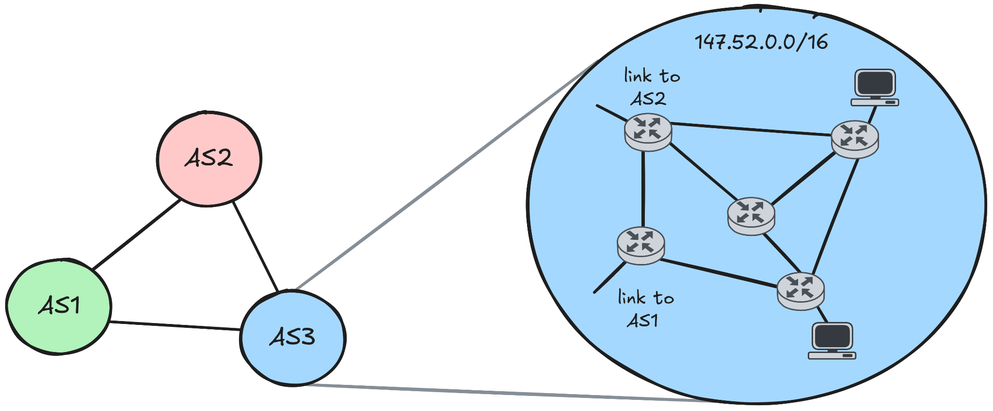
Autonomous System

Slide 40
AS Routing Protocols
Intra-AS routing
Determines how the traffic flows inside the AS
Example: OSPF, IGRP, RIP, IS-IS
Inter-AS routing
Determines how the traffic flows among different ASes
Example: BGP
  This is what the actual Internet uses

Slide 41
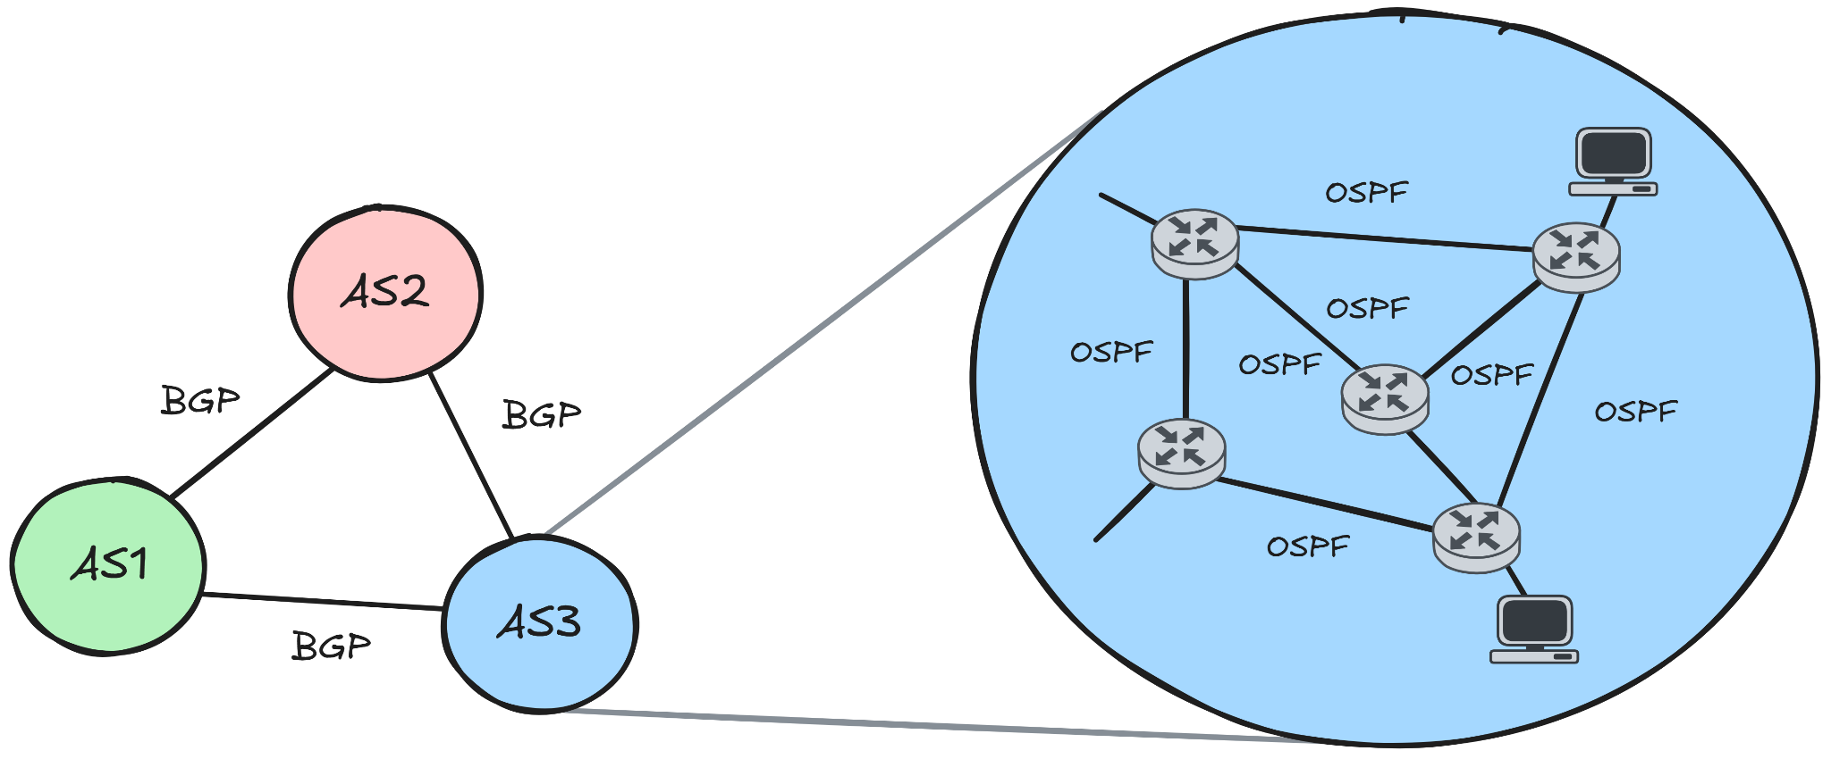
AS Routing Protocols

Slide 42
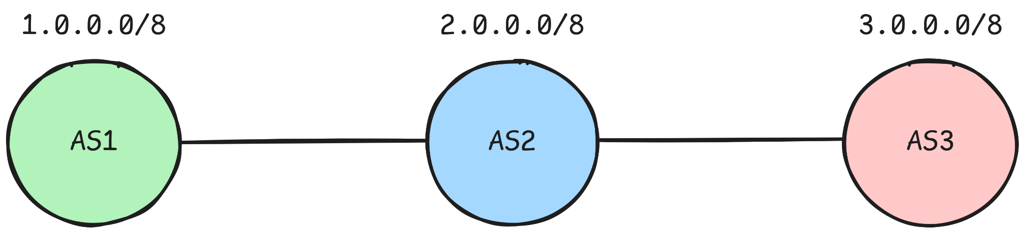
Border Gateway Protocol (BGP)
Purpose: routing between ASes
An AS will advertise its prefix so that it is known to the rest of the Internet
It does not calculate routes towards a specific IP
But to a prefix that belongs to an AS
Uses Path Vector algorithm
  A modified version of distance vector
  Uses paths (sequence of ASes) instead of distances

Slide 43
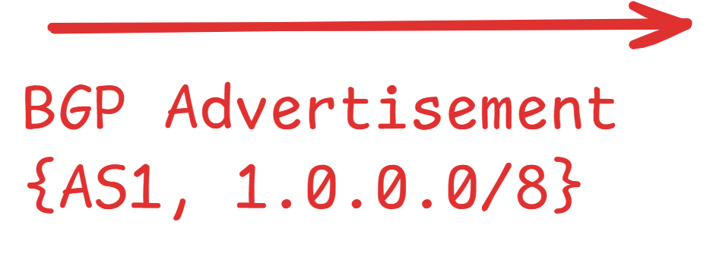
Border Gateway Protocol (BGP)
Let’s see a simplified example:
AS1 will send a BGP advertisement to its neighbor AS2
Includes: ASN and its prefix

Slide 44
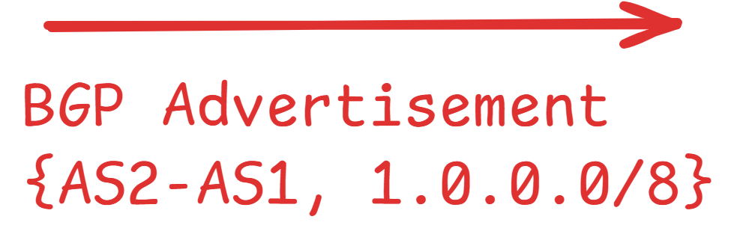
Border Gateway Protocol (BGP)
AS2 will add its ASN to the AS-PATH
And send a BGP advertisement to its neighbor AS3

Slide 45
Border Gateway Protocol (BGP)
Now AS2 and AS3 know that:
to reach any destination IP that belongs to prefix 1.0.0.0/8
must send to AS1

Slide 46
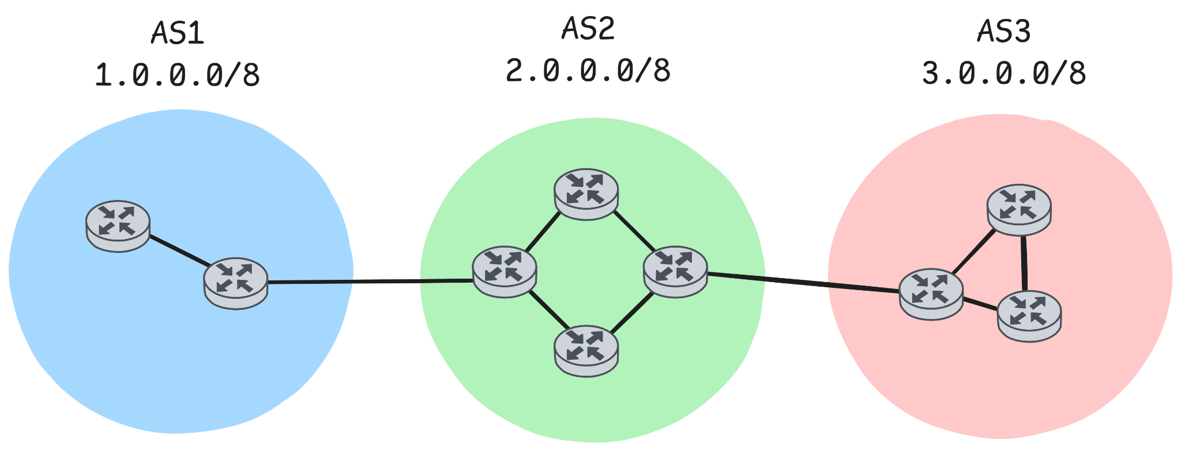
Border Gateway Protocol (BGP)
Let’s take a closer look at BGP:
Gateway router: router that connects to another AS
Internal router: router inside an AS, connects only to routers/hosts inside that AS

Slide 47
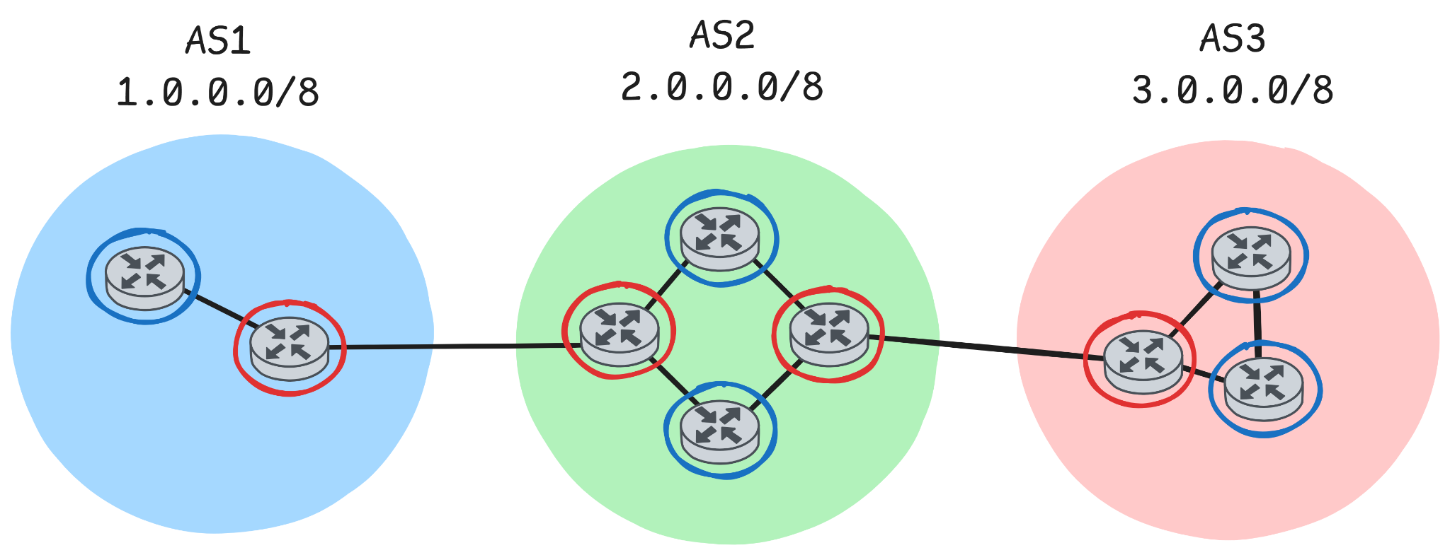
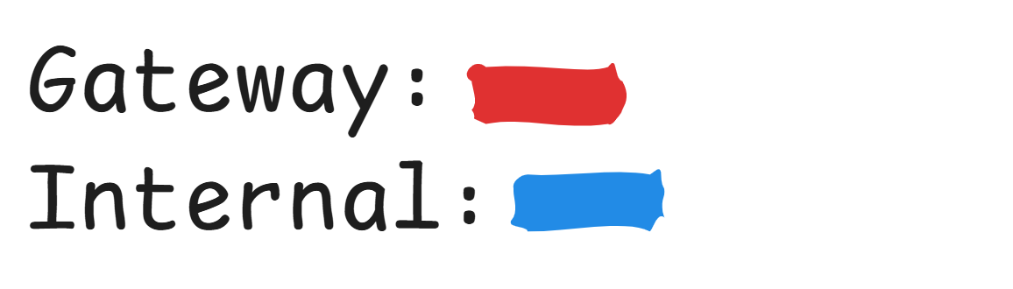
BGP - Routers
Let’s take a closer look at BGP:
Gateway router: router that connects to another AS
Internal router: router inside an AS, connects only to routers/hosts inside that AS

Slide 48

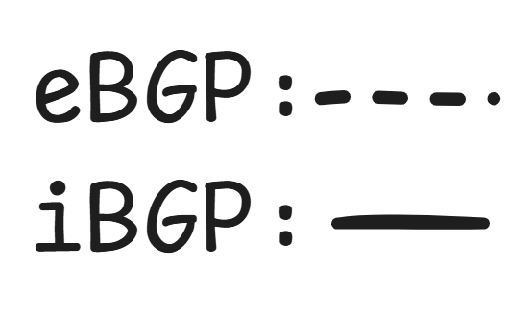
BGP - eBGP & iBGP
BGP is separated to two protocols:
eBGP: exchange reachability information from neighboring ASes
iBGP: propagate this information to all AS-internal routers
  Internal routers run iBGP,
  Gateway routers run both eBGP and iBGP

Slide 49
BGP - Attributes
Beside prefix, BGP advertisements include attributes
Prefix + Attributes = BGP Route
Some important attributes:
  AS-PATH: Shows the ASes from which the advertisement has passed through (the sequence of ASNs we saw in previous examples)
  NEXT-HOP: Shows the IP of the next hop router interface, that the AS-PATH starts from

Slide 50

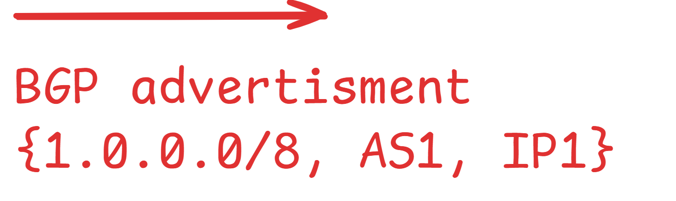
Border Gateway Protocol (BGP)

Slide 51
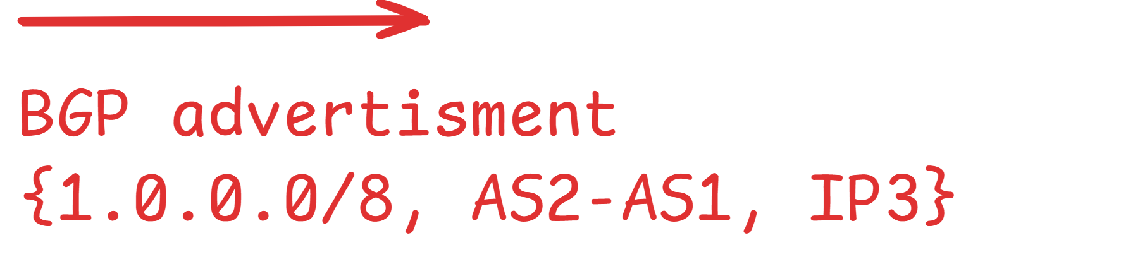
Border Gateway Protocol (BGP)

Slide 52
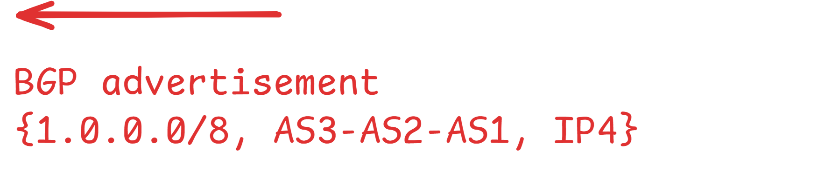
BGP - Loop Prevention
AS3 will advertise the route back to AS2, since AS2 is a neighbor
That could lead to advertisement loops
  AS3 sends to AS2, AS2 sends to AS1 and AS2 again and so on…

Slide 53

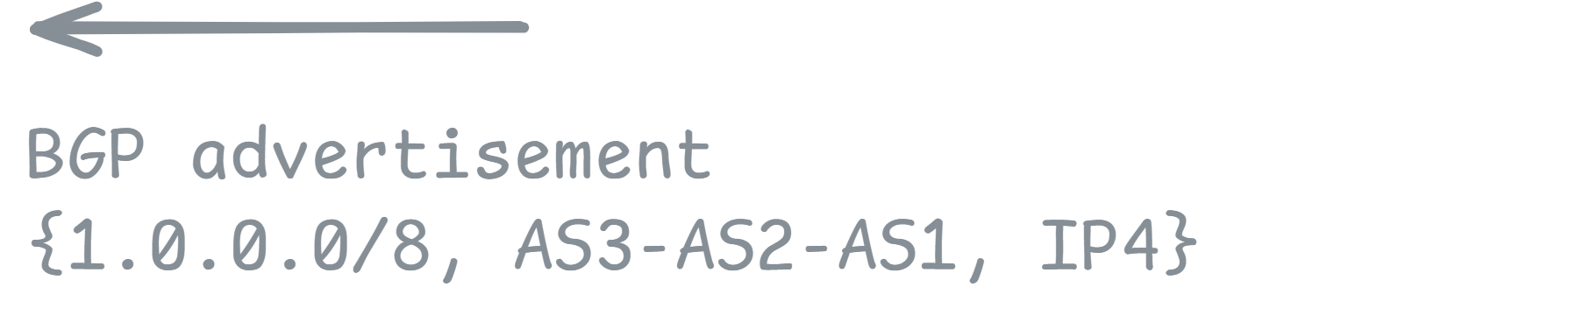
BGP - Loop Prevention
To prevent loops, if an AS sees its own ASN in the AS-PATH
It discards the advertisement
That’s my ASN in the AS-PATH → Discard

Slide 54
BGP - Path Selection
How are paths chosen?
By default BGP chooses the shortest path
  Path that passes through the least ASes
Local Preference: a BGP attribute
  An integer value
  Used to apply policies (i.e. prefer to send traffic through this AS, avoid this AS etc.)
  Paths with higher local preference are prefered

Slide 55
Sum Up
Routing Algorithms
Link-State Routing Algorithms
(Centralized)
Decentralized Routing Algorithms
Dijkstra’s Algorithm
A link-state algorithm
Distance Vector Algorithm
A decentralized algorithm
Uses the Bellman-Ford equation
OSPF
Protocol that uses Dijkstra’s Algorithm
Intra-AS routing
BGP
Protocol that uses Path Vector algorithm
(a modification of Distance Vector)
Inter-AS routing

Slide 56
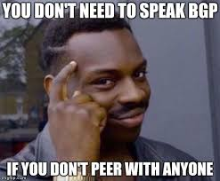
Questions???

